Slide 1
KNUST COVID-19 AWARENESS
COVID-19: Caused by a virus known as Severe Acute Respiratory Syndrome Coronavirus-2 (SARS-CoV-2). Spreads very easily from person to person.
Signs and symptoms: Fever or chills, cough, difficulty in breathing, cold, headache, diarrhoea, loss of taste/smell, and several non-specific symptoms.
Transmission: Respiratory droplets, airborne, contaminated surfaces.
Prevention: Adhere to the KNUST COVID-19 safety protocols
Respiratory hygiene: Wear a nose mask, cough etiquettes
Hand hygiene: Frequent hand washing, hand sanitizing
Maintain ‘safe’ physical distancing
Avoid crowds and confined/poorly ventilated spaces
Virus is changing itself with even more serious ramifications, so it is important we all adhere to the safety protocols

Slide 2
BCHEM 471 Immunology
Dr. A. Kwarteng
Department of Biochemistry and Biotechnology, KNUST, Kumasi
E-mail: akwarteng@knust.edu.gh

Slide 3
AIM
To appreciate how components of the immune system work to protect against development of clinical disease.
The basic systems and cells involved in immune responses will be presented to give a general overview of functional immunity.
Components and systems will be defined to allow an understanding of concepts of innate (always present) and adaptive (inducible and specific) responses, and how these responses interact with one another to form the basis for protection against disease
Department of Biochemistry and Biotechnology
Immunology

Slide 4
Importance of Immunology
A) Vaccines
B) Recombinant DNA technology
C) Monoclonal and Polyclonal Antibody technology
D) Improving transplant outcomes
E) Treatment outcomes
F) Global eradication of diseases
Department of Biochemistry and Biotechnology
Immunology

Slide 5
Industrial Application
Biomedical Research Institutions
WHO, CDC
Research Universities
Pharmaceutical companies
Ministry of Health
Hospitals
Vertinary centers
Biomed and Biotech companies
Forensic institutions
Department of Biochemistry and Biotechnology
Immunology

Slide 6
Salary Range
48,000-60,000 GHC p/a
80,000-120,000 USD p/a
Department of Biochemistry and Biotechnology
Immunology

Slide 7
What is Immunology?
Immunology is defined at the study of the immune system.
The immune system is a system of cells, tissues and their soluble products that recognizes, attacks and destroys agents that could be harmful to the health of an individual or organism.
In principle the normal functioning of immune system lead to immunity.
Department of Biochemistry and Biotechnology
Immunology

Slide 8
What is Immunity?
The Latin term immunitas, meaning “exempt,” gave rise to the English word immunity, which refers to all the mechanisms used by the body as protection against environmental agents that are foreign to the body.
These agents may be microorganisms or their products, foods, chemicals, drugs, pollen, or animal hair and dander.
The concept of immunity dates back to 1500s, before the cause of disease was understood. Survivors after exposure to deadly disease were referred to as except from or immune.
Department of Biochemistry and Biotechnology
Immunology

Slide 9
Pioneers of Immunology
Edward Jenner (1796), one of the pioneers who solidified the birth of immunology
Jenner observed that dairymaids and farmers lacked the pock-marked complexions of their fellow citizens, and wondered whether those who worked with cattle might be resistant to smallpox because of their close contact with livestock.
Department of Biochemistry and Biotechnology
Immunology

Slide 10
Cows of that era often suffered from cowpox disease, a disorder similar to smallpox but much less severe.
In an experiment that would be prohibited on ethical grounds today, Jenner deliberately exposed an 8-year-old boy to fluid from a cowpox lesion.
Two months later, he inoculated the same boy with infectious material from a smallpox patient.
In this first example of successful vaccination, the boy did not develop smallpox. Jenner’s approach to smallpox prevention was quickly adopted in countries throughout Europe.
Department of Biochemistry and Biotechnology
Immunology

Slide 11
ROBERT KOCH
In 1884, Robert Koch proposed the “germ theory of disease,”
Which stated “that microbes invisible to the naked eye were responsible for specific illnesses”
The first human disease-causing organisms or pathogens were identified in the late 1800s
Department of Biochemistry and Biotechnology
Immunology

Slide 12
At about the same time, Louis Pasteur applied Jenner’s immunization technique for smallpox to the prevention of various animal diseases.
Pasteur demonstrated that inoculation with a pathogen that had been weakened in the laboratory could protect against a subsequent exposure to the naturally occurring pathogen.
It was Pasteur who coined the term vaccination (from the Latin vaccinus, meaning “derived from cows”) for this procedure, in honor of Jenner’s work.
The research of Pasteur and other investigators spurred the evolution of immunology as a science distinct from (but related to) the established fields of microbiology, pathology, biochemistry and histology
Department of Biochemistry and Biotechnology
Immunology

Slide 13
Today, immunology can be defined :
As the study of the cells and tissues that mediate immunity and the investigation of the genes and proteins underlying their function.
Department of Biochemistry and Biotechnology
Immunology

Slide 14
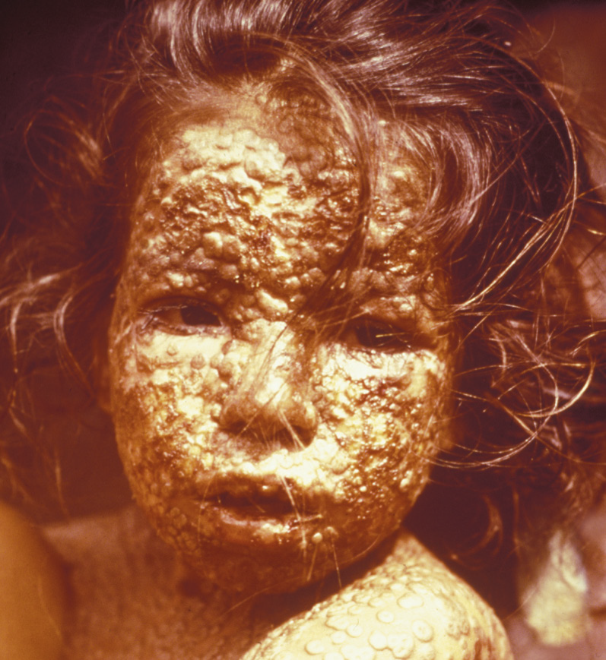
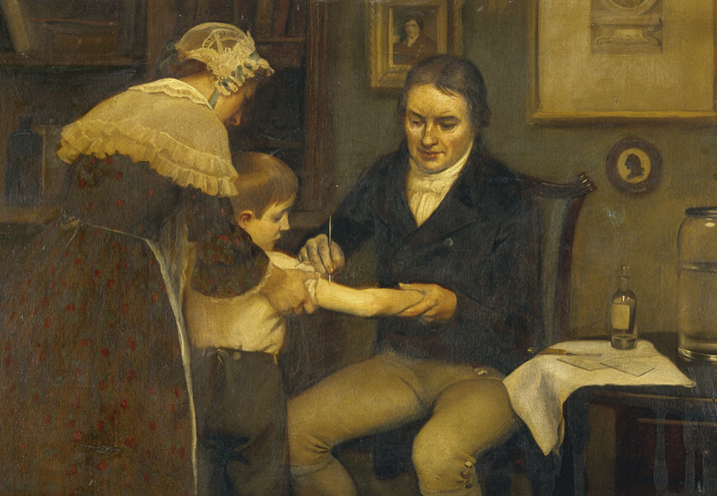
Smallpox Immunization
Smallpox infection in Bangladesh girl in 1973
Edward Jenner vaccinating James Philips against smallpox
Department of Biochemistry and Biotechnology
Immunology

Slide 15
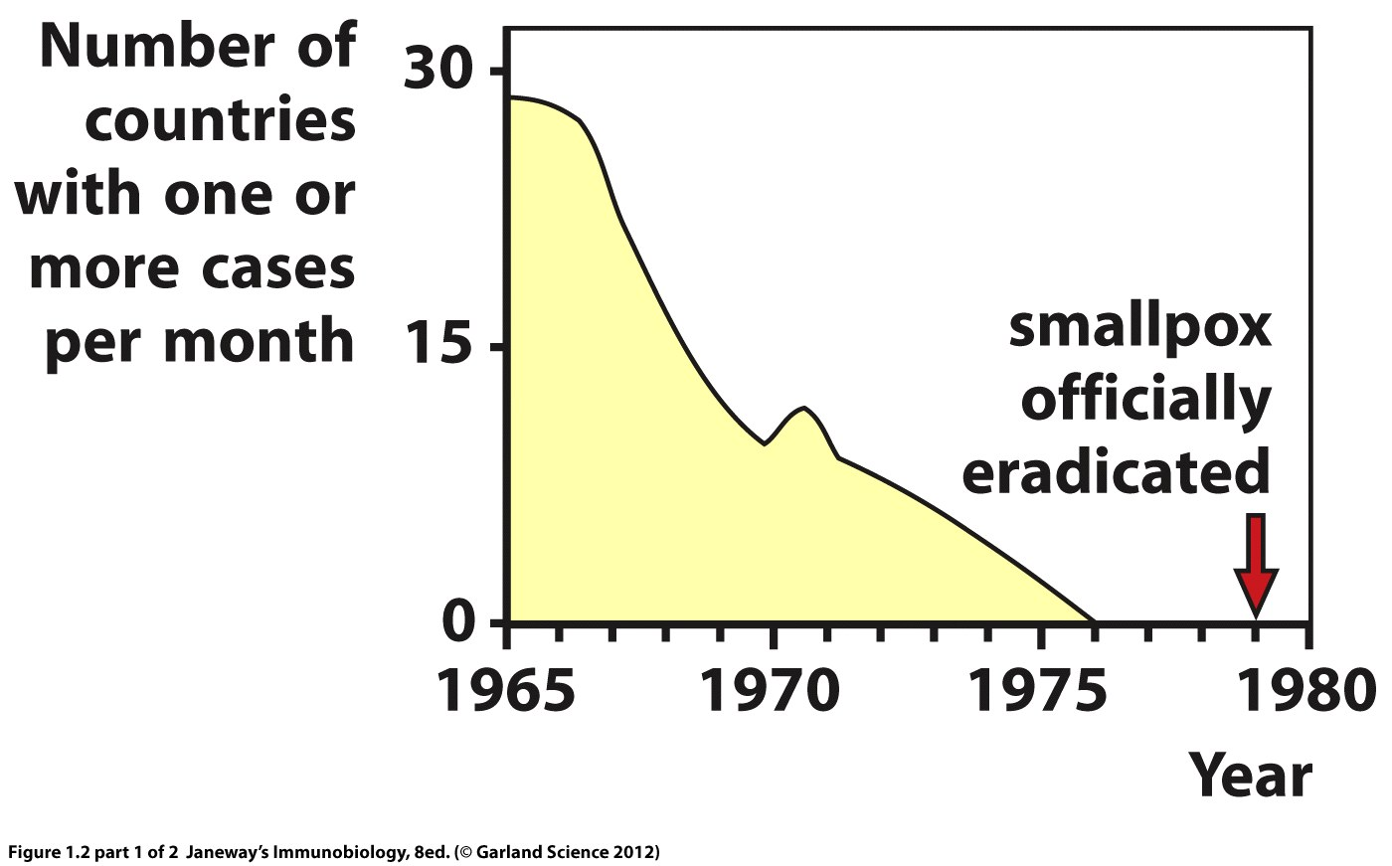
Department of Biochemistry and Biotechnology
Immunology

Slide 16
What is the nature of Immune Response
A normal healthy person’s body always strives to maintain homeostasis, a natural state of balance of all its organs and the nervous and circulatory systems
When this homeostasis is disturbed by trauma, pathogens, or the deregulation of body cells (as in cancer), the immune system responds in an attempt to restore balance.
Department of Biochemistry and Biotechnology
Immunology

Slide 17
At its simplest level, this response involves identifying and clearing damaged and dying cells from the body.
More complex responses have evolved to counteract assault on the body by infectious agents, including bacteria, viruses, parasites and fungi.
Because these foreign invaders are literally everywhere on Earth and constantly seeking vulnerable hosts, the immune system is constantly occupied with containing attacks.
Department of Biochemistry and Biotechnology
Immunology

Slide 18
Humans are surrounded by other organisms-in the air, in the soil, in the water, on the skin, and on the mucosae, the protective layers of epithelial cells that line the gastrointestinal, urogenital and respiratory tracts.
While most of these organisms are harmless and some are even beneficial, some are pathogenic.
Like all species, pathogens live to reproduce. In order to reproduce, however, many must penetrate a host’s body or one of its component cells.
Department of Biochemistry and Biotechnology
Immunology

Slide 19
What is infection?
Infection is defined as the attachment and entry of a pathogen into the host.
Once inside the body or cell, the pathogen replicates, generating progeny that spread into the body in a localized or systemic fashion.
The manner of this replication determines whether the pathogen is considered extracellular or intracellular.
Department of Biochemistry and Biotechnology
Immunology

Slide 20
Extracellular pathogens
Certain bacteria and parasites do not need to enter cells to reproduce.
After accessing the body, these organisms replicate first in the interstitial fluid bathing the tissues and may then disseminate via the blood.
Department of Biochemistry and Biotechnology
Immunology

Slide 21
Intracellular pathogens
Pathogens such as viruses and other bacteria and parasites, enter a host cell, subvert its metabolic machinery, and cause it to churn out new virus particles, bacteria, or parasites.
These pathogens may then also travel systemically by entering the blood.
Department of Biochemistry and Biotechnology
Immunology

Slide 22
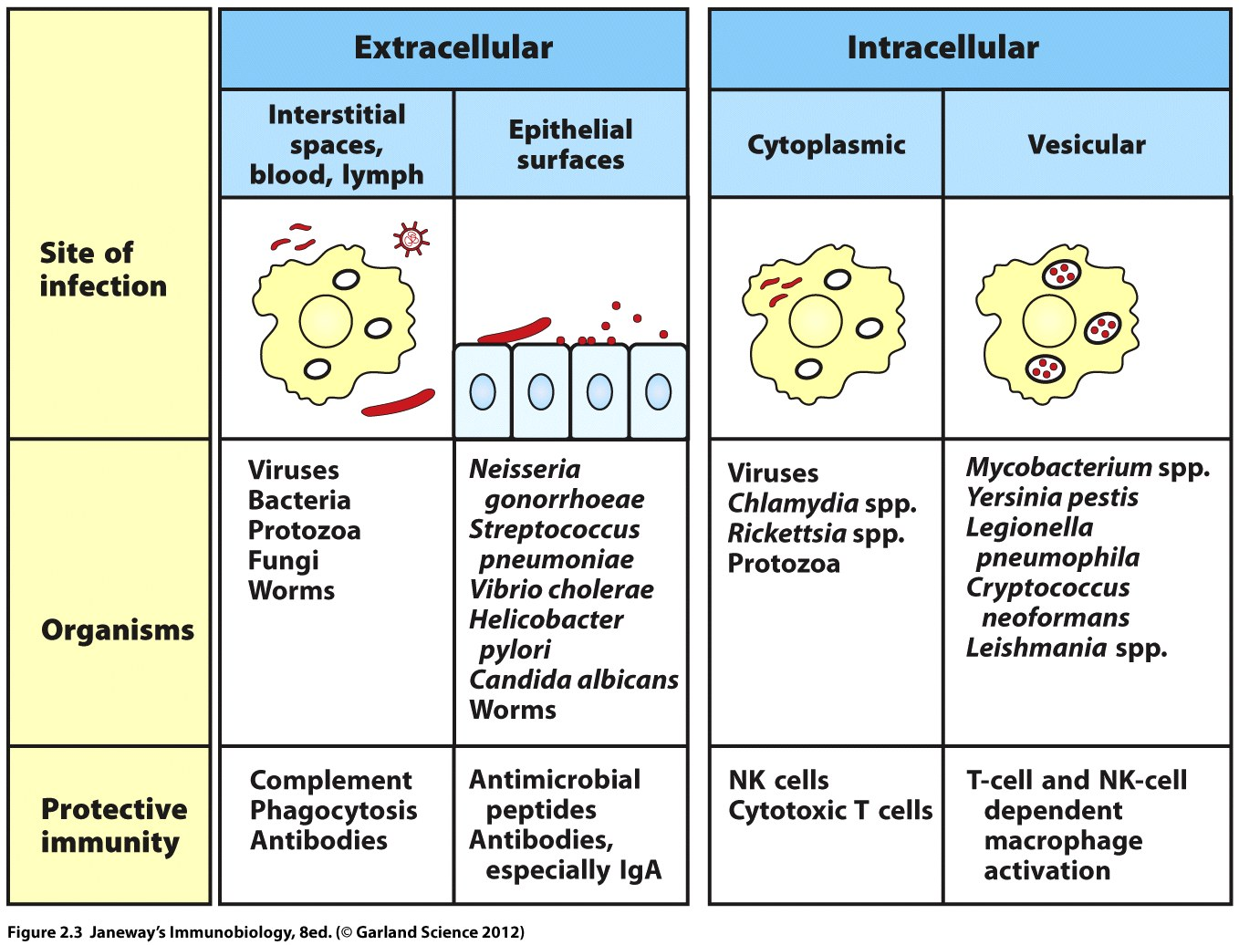
Department of Biochemistry and Biotechnology
Immunology

Slide 23
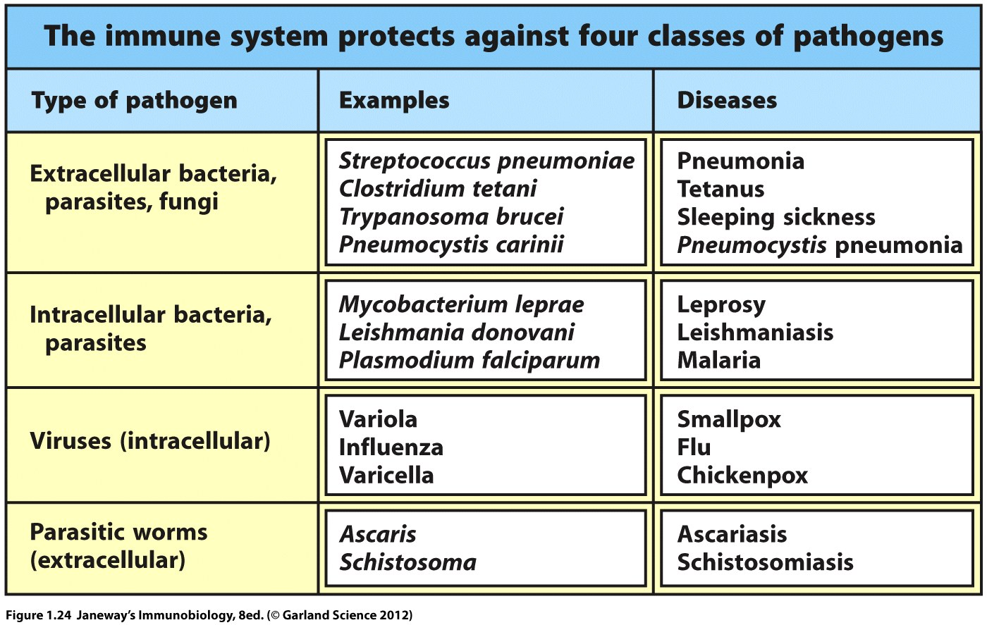
Department of Biochemistry and Biotechnology
Immunology

Slide 24
Types of Immune Response
The mammalian immune system can mount two types of responses:
innate response is triggered by disruptions to homeostasis caused by either non-infectious or infectious means
adaptive response that is composed of highly specialized, systemic cells and processes that eliminate or prevent pathogen growth
Department of Biochemistry and Biotechnology
Immunology

Slide 25
Mechanisms Underlaying Immune Responses
There were two schools of thought on what mechanisms underlay immune responses.
One group of scientists believed that immunity depended primarily on the actions of cells that destroyed or removed unwanted material from the body. This clearance process was referred to as cell-mediated immunity.
However, another group of researchers was convinced that soluble molecules in the serum of the blood could directly eliminate foreign entities without the need for cellular involvement. In this case, the clearance process was referred to as humoral immunity, a term derived from the historical description of body fluids as “humors.”
Department of Biochemistry and Biotechnology
Immunology

Slide 26
Today, we know that both cell-mediated and humoral responses occur simultaneously during an immune response and that both are often required for complete clearance of a threat.
Department of Biochemistry and Biotechnology
Immunology

Slide 27
The cells responsible for cell-mediated immunity are collectively called leukocytes or white blood cells.
The soluble molecules responsible for humoral immunity are proteins called antibodies, and antibodies are secreted by a particular type of leukocyte. In this case a B cell (plasma cell).
Department of Biochemistry and Biotechnology
Immunology

Slide 28
Antibodies protect against extracellular pathogens and their toxic products
Department of Biochemistry and Biotechnology
Immunology

Slide 29
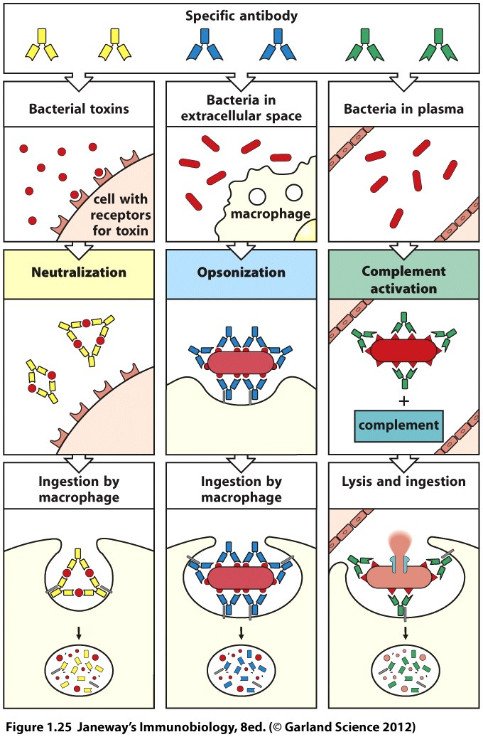
Department of Biochemistry and Biotechnology
Immunology

Slide 30
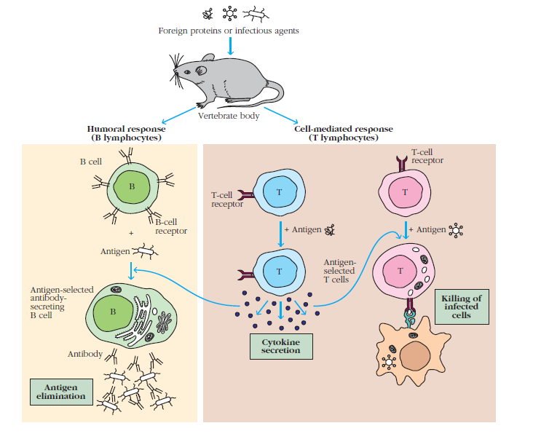
Humoral and Cell-mediated Immunity
Department of Biochemistry and Biotechnology
Immunology

Slide 31
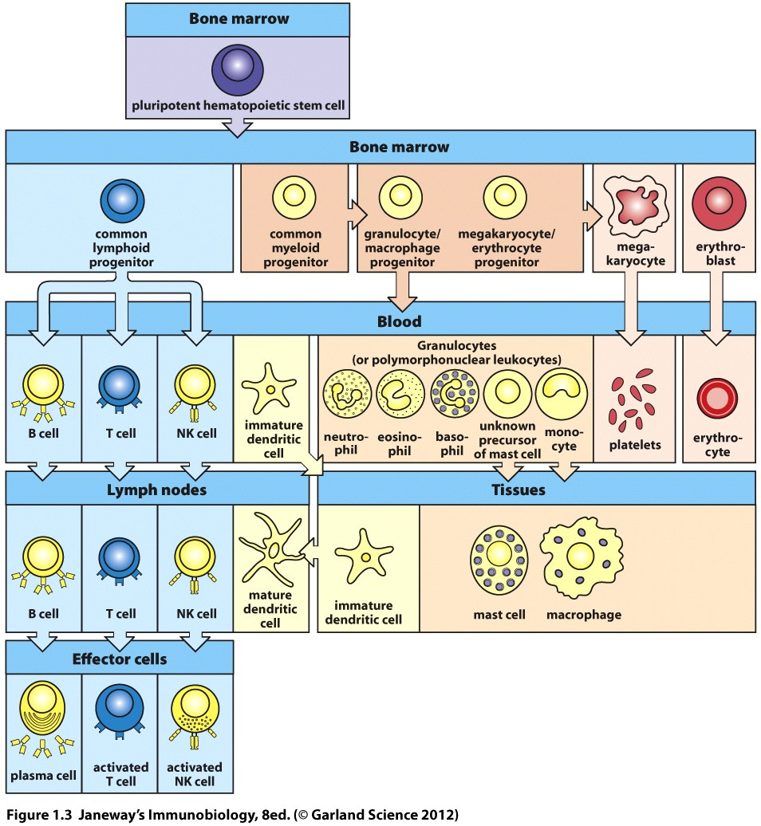
Cells of the Immune System
Department of Biochemistry and Biotechnology
Immunology

Slide 32
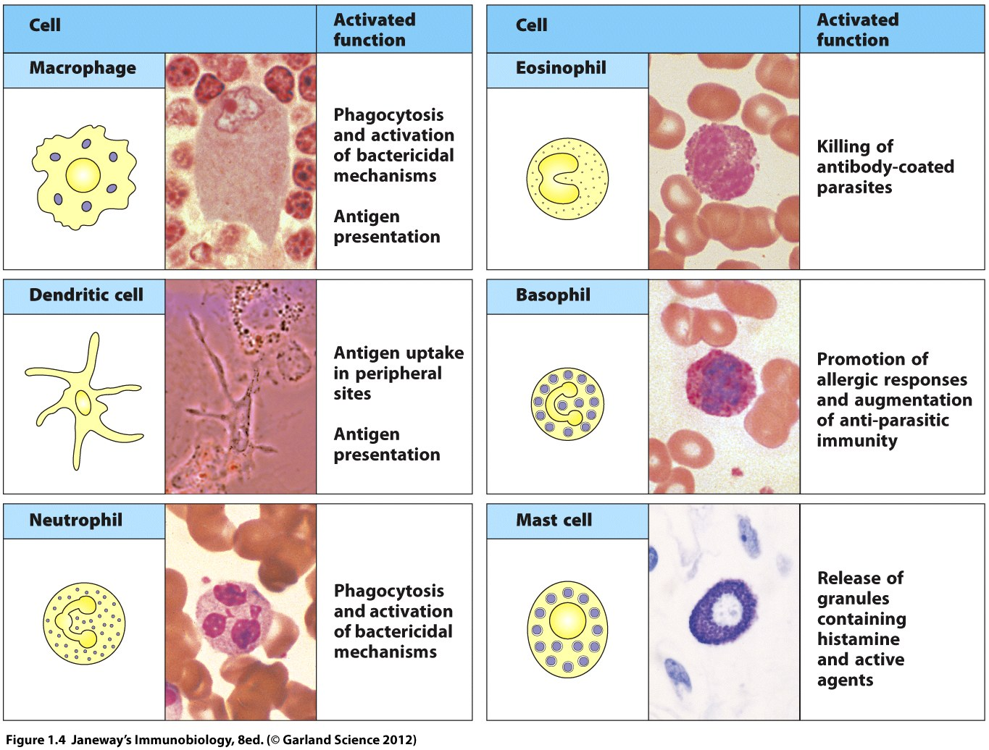
Department of Biochemistry and Biotechnology
Immunology

Slide 33
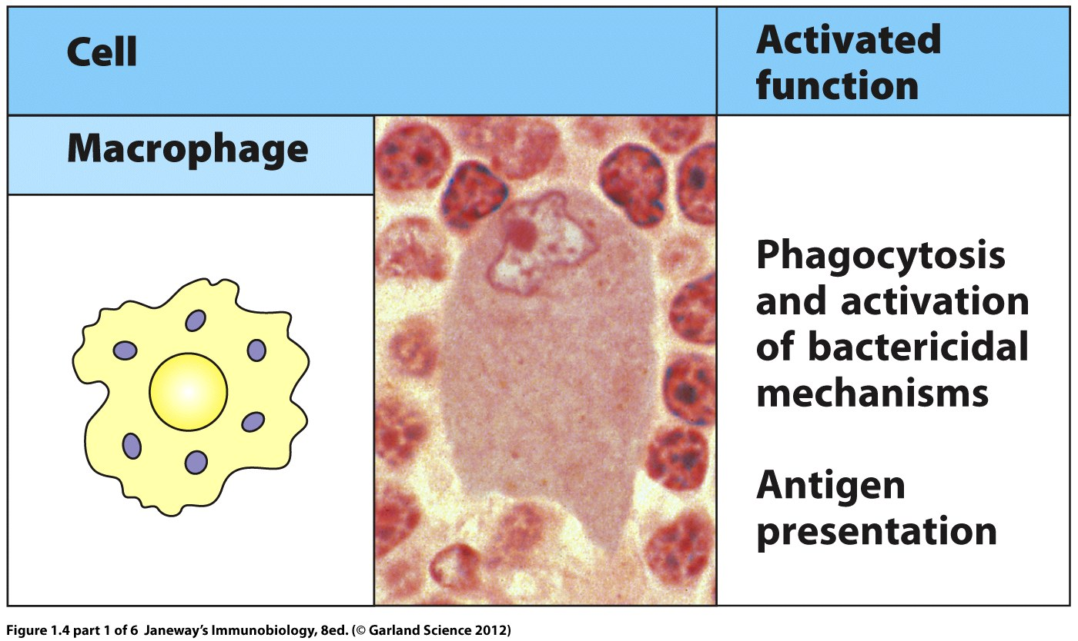
Department of Biochemistry and Biotechnology
Immunology

Slide 34
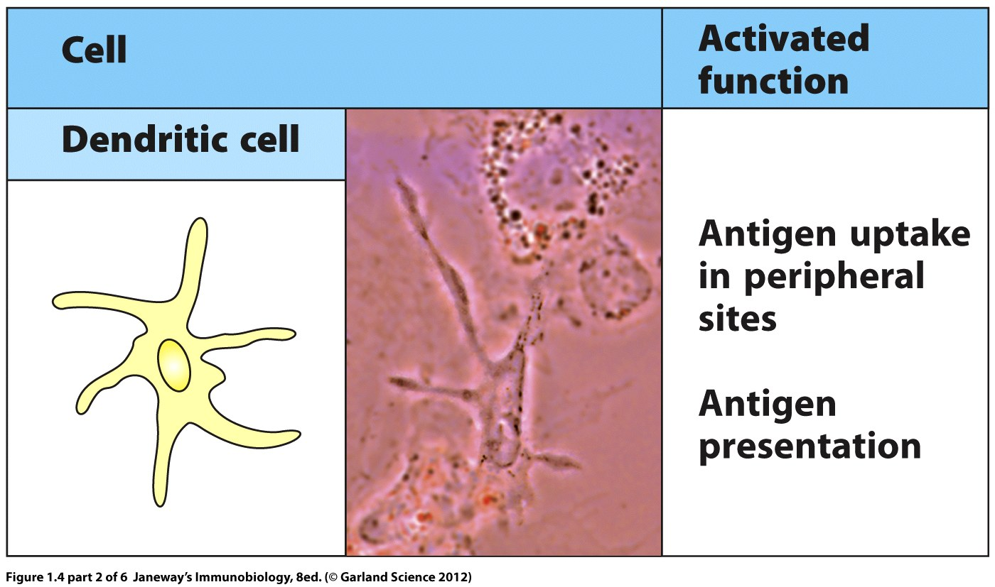
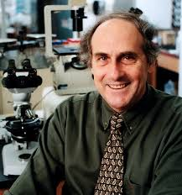
DCs were first characterized by Ralph Steinman. Dr. Steinman was awarded a share in the 2011 Nobel Prize in Physiology or Medicine for his seminal work.
Department of Biochemistry and Biotechnology
Immunology

Slide 35
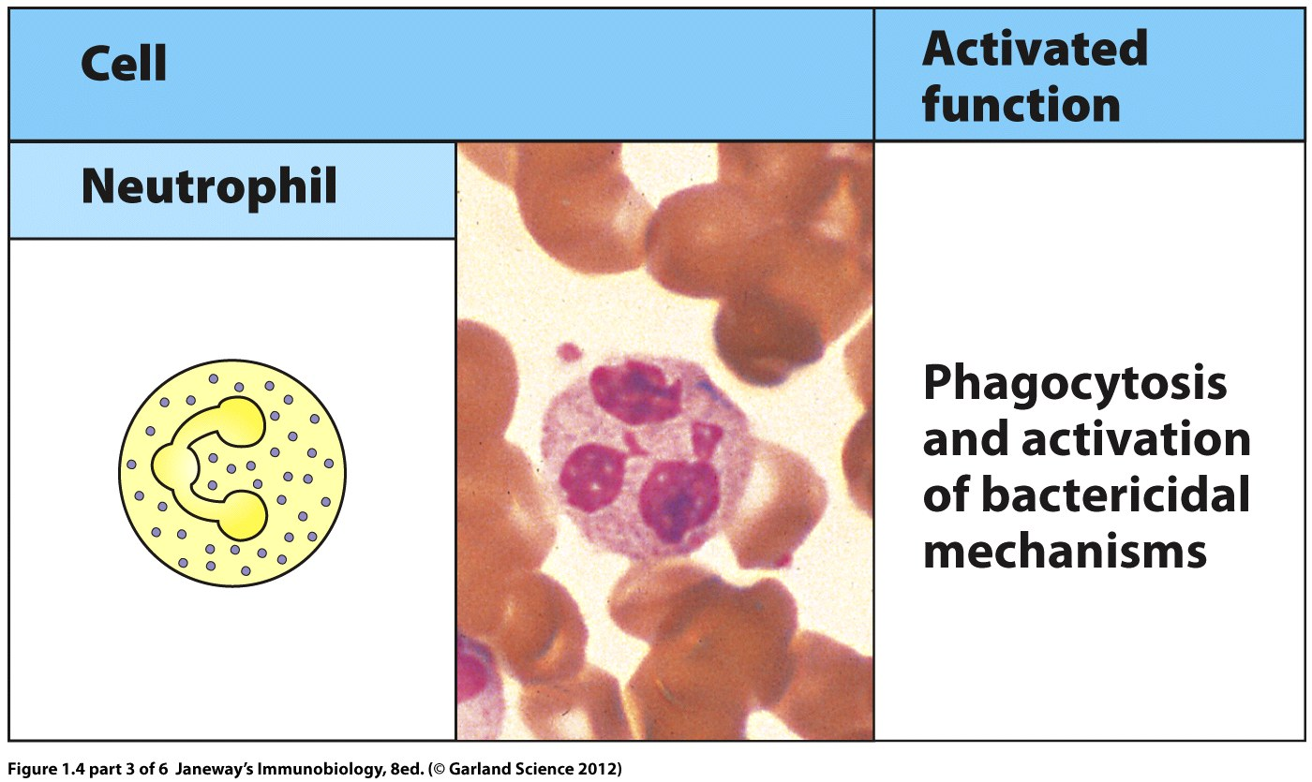
Neutrophils or PMN: polymorphonuclear leukocytes Cells in blood stream, not in healthy tissues Become attracted by activated macrophages
Department of Biochemistry and Biotechnology
Immunology

Slide 36
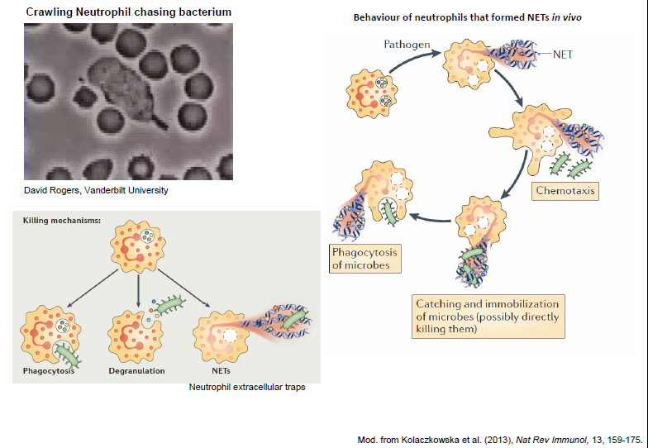
Neutrophil Recruitment
Department of Biochemistry and Biotechnology
Immunology

Slide 37
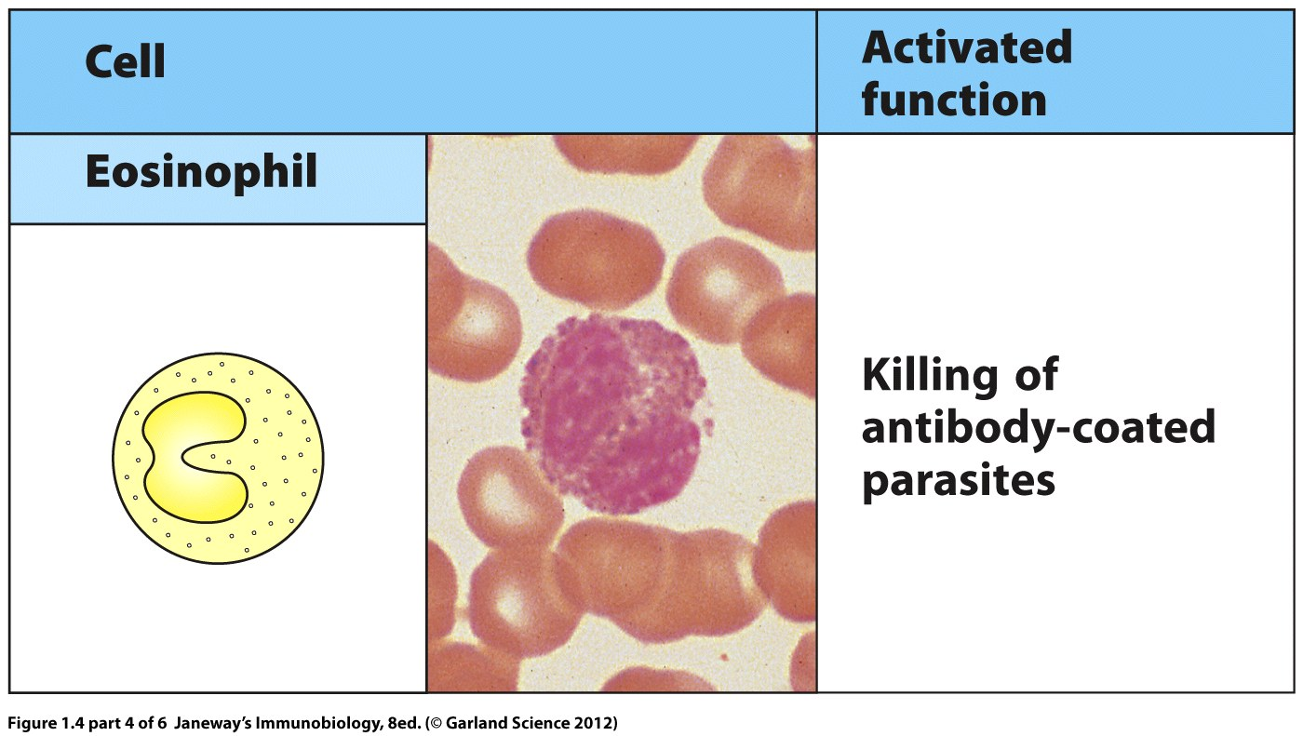
Contain granula with argini-rich basic proteins, which can be stained by eosin In peripheral tissue, low numbers in blood After activation, they release granula with toxic substances that kill microorganisms esp. parasites but can also damage host in allergy; release cytokines to attract other cells
Department of Biochemistry and Biotechnology
Immunology

Slide 38
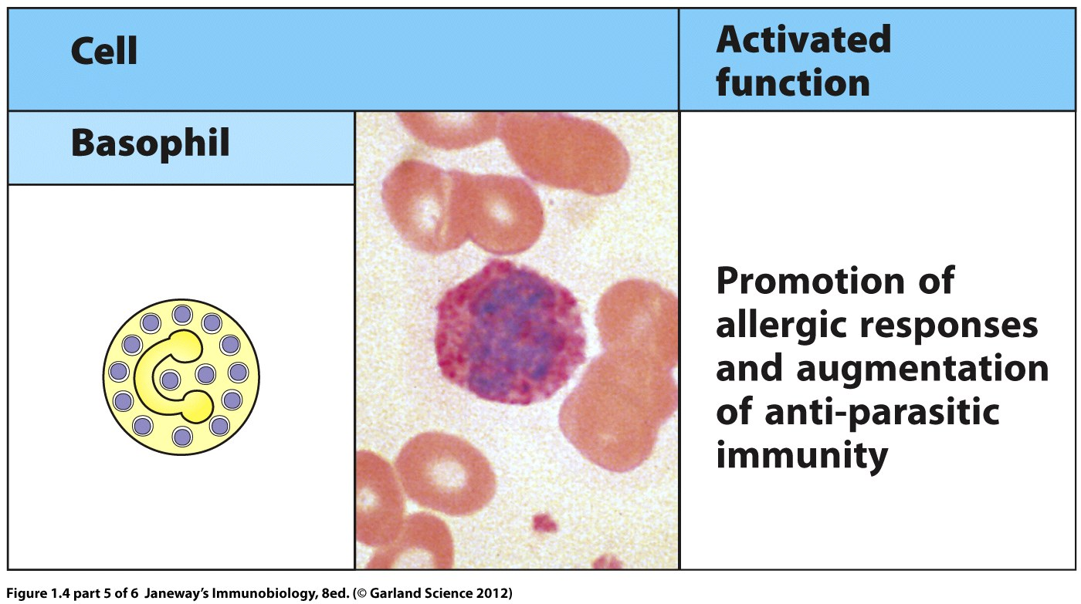
Function similar to Eosinophils (common precursor) but differentiation is mediated by other cytokines (e.g. IL-3) low numbers in blood, recruitment and activation by cytokines, Fc receptor recognizes Ab-conjugated antigens, secretion of toxic granules
Department of Biochemistry and Biotechnology
Immunology

Slide 39
Introduction to Innate Immune response

Slide 40
Features of Innate Immune Response
Barrier Defense
Complement Activation
Pattern Recognition
Inflammation
Phagocytosis
Department of Biochemistry and Biotechnology
Immunology

Slide 41
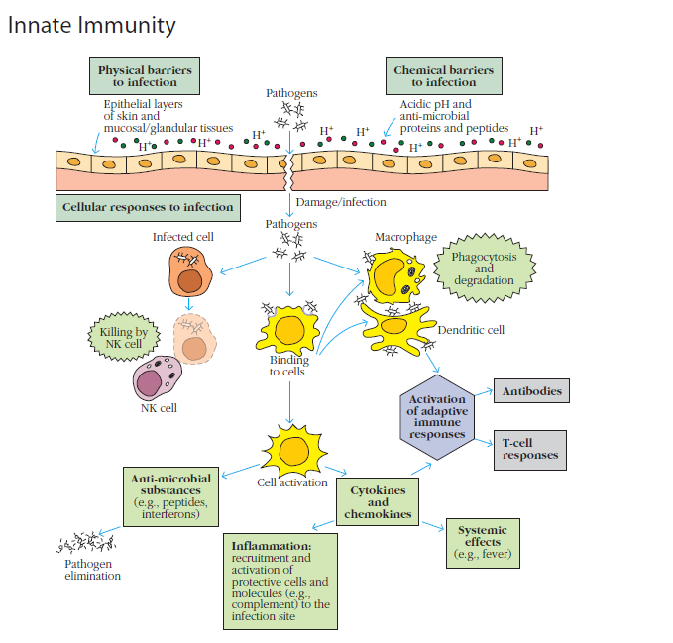
Department of Biochemistry and Biotechnology
Immunology

Slide 42
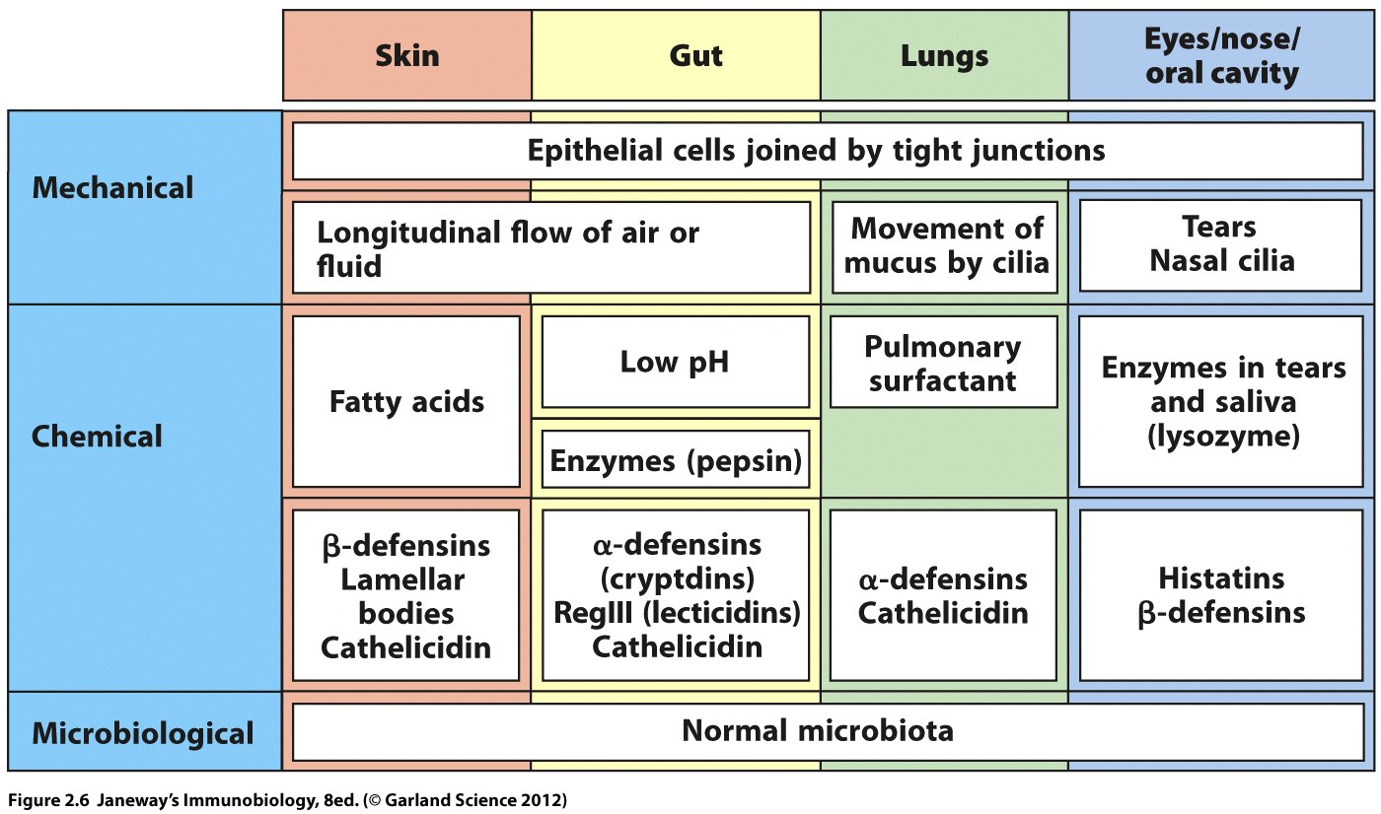
Barriers of the Host Immune System
Department of Biochemistry and Biotechnology
Immunology

Slide 43
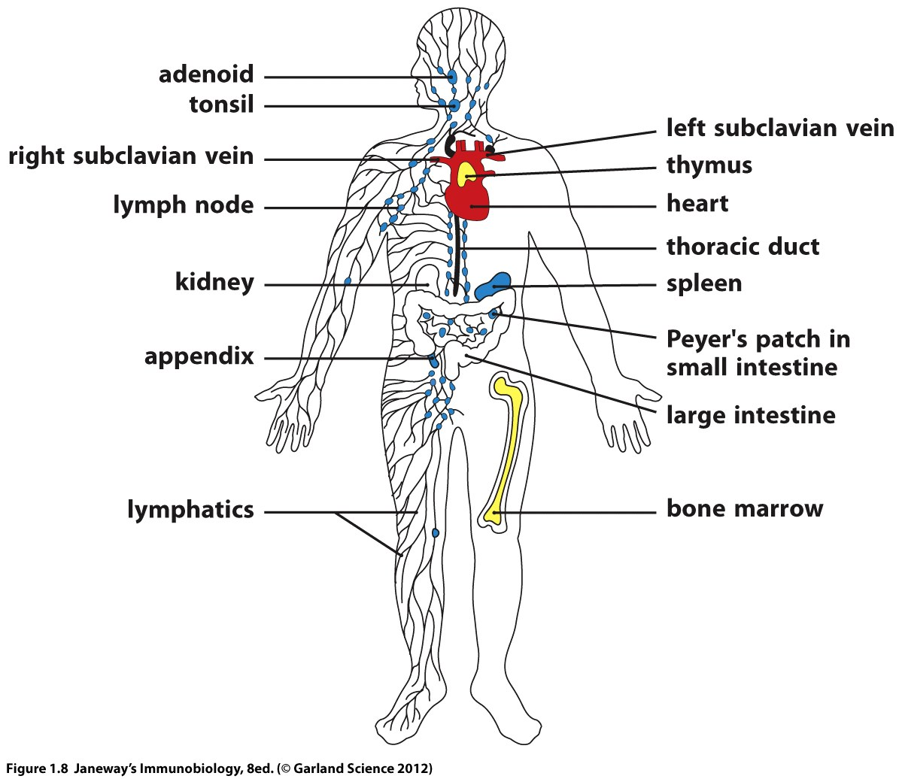
Distribution of lymphoid tissues in the body
MALT, BALT
GALT
NALT
SALT
Primary lymphoid tissues
Secondary lymphoid tissues
Department of Biochemistry and Biotechnology
Immunology

Slide 44
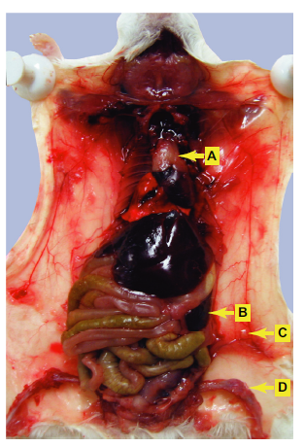
Primary and Secondary Lymph organs
Thymus
Spleen
Lymph node
Bone Barrow
Department of Biochemistry and Biotechnology
Immunology

Slide 45
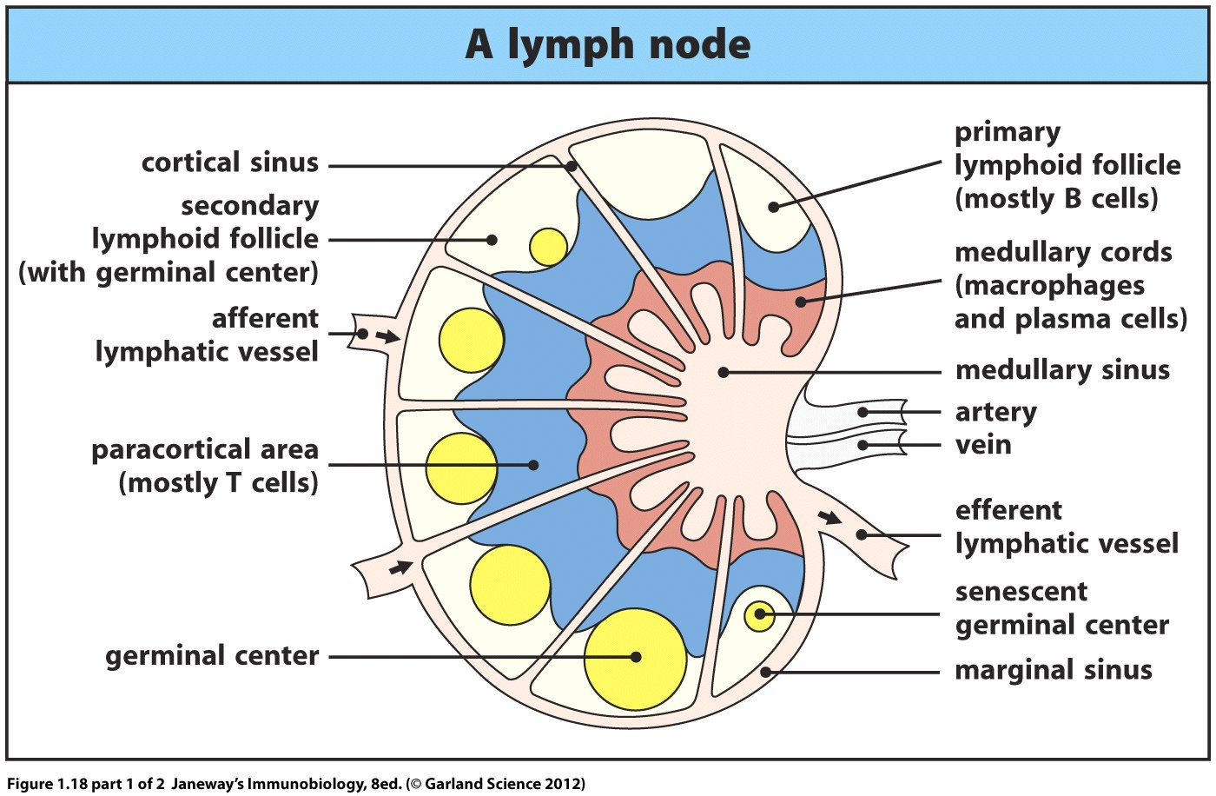
Organization of a lymph node
Department of Biochemistry and Biotechnology
Immunology

Slide 46
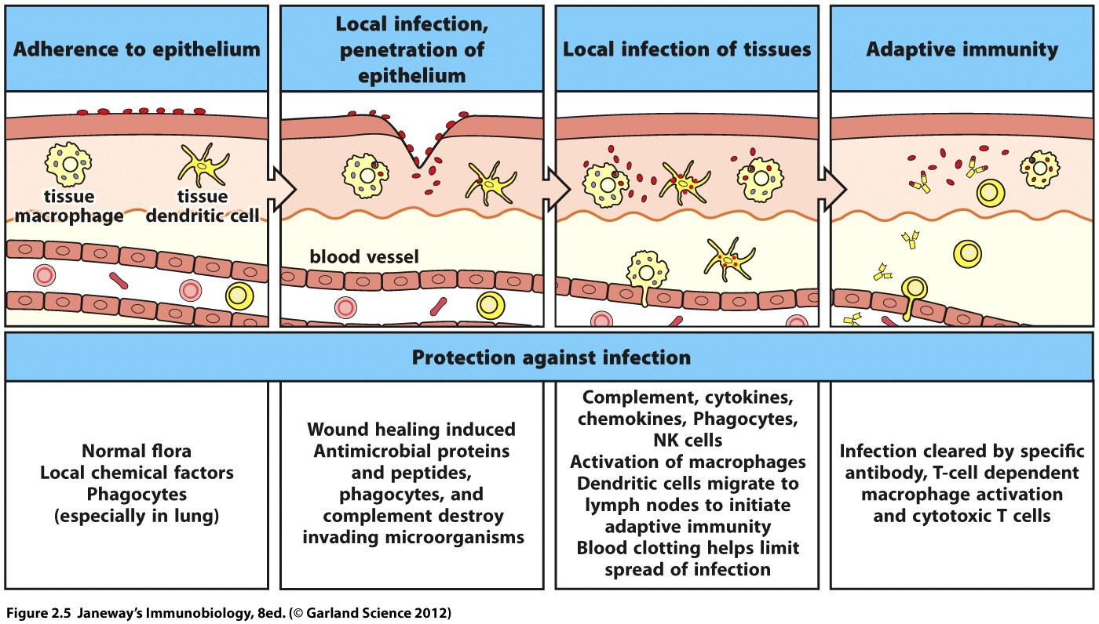
Protection Against Infection
Department of Biochemistry and Biotechnology
Immunology

Slide 47
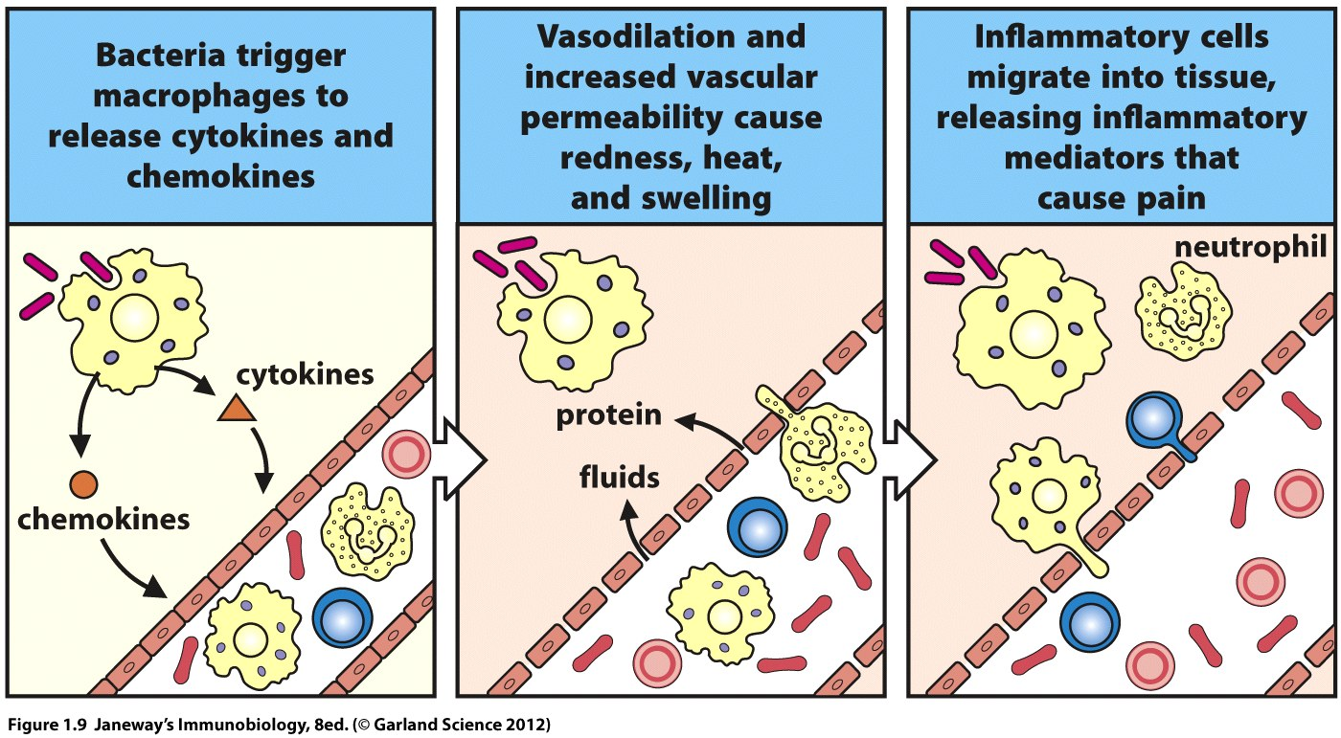
Infection triggers an inflammatory response
Department of Biochemistry and Biotechnology
Immunology

Slide 48
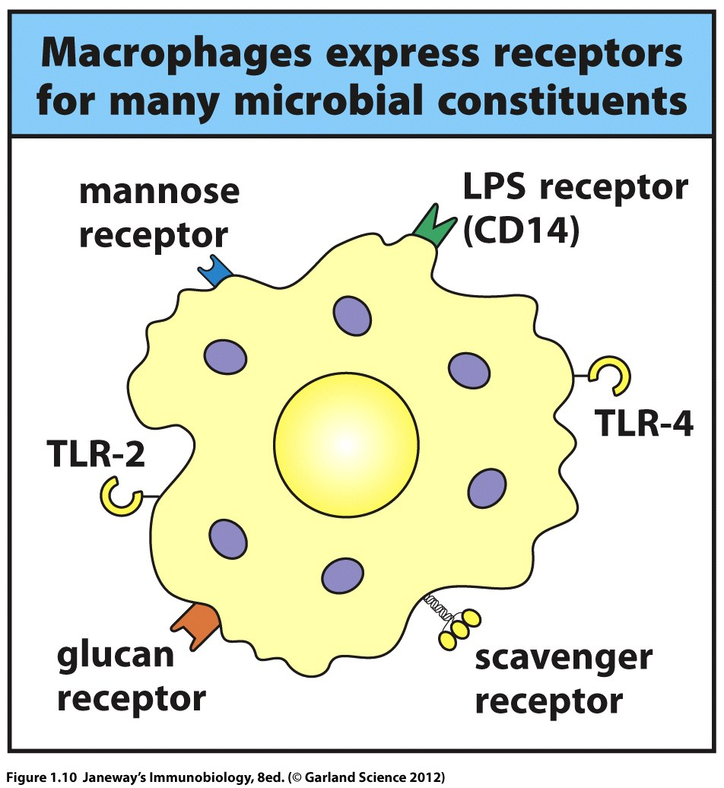
Infection triggers Pathogen Recognition an inflammatory response
Department of Biochemistry and Biotechnology
Immunology

Slide 49
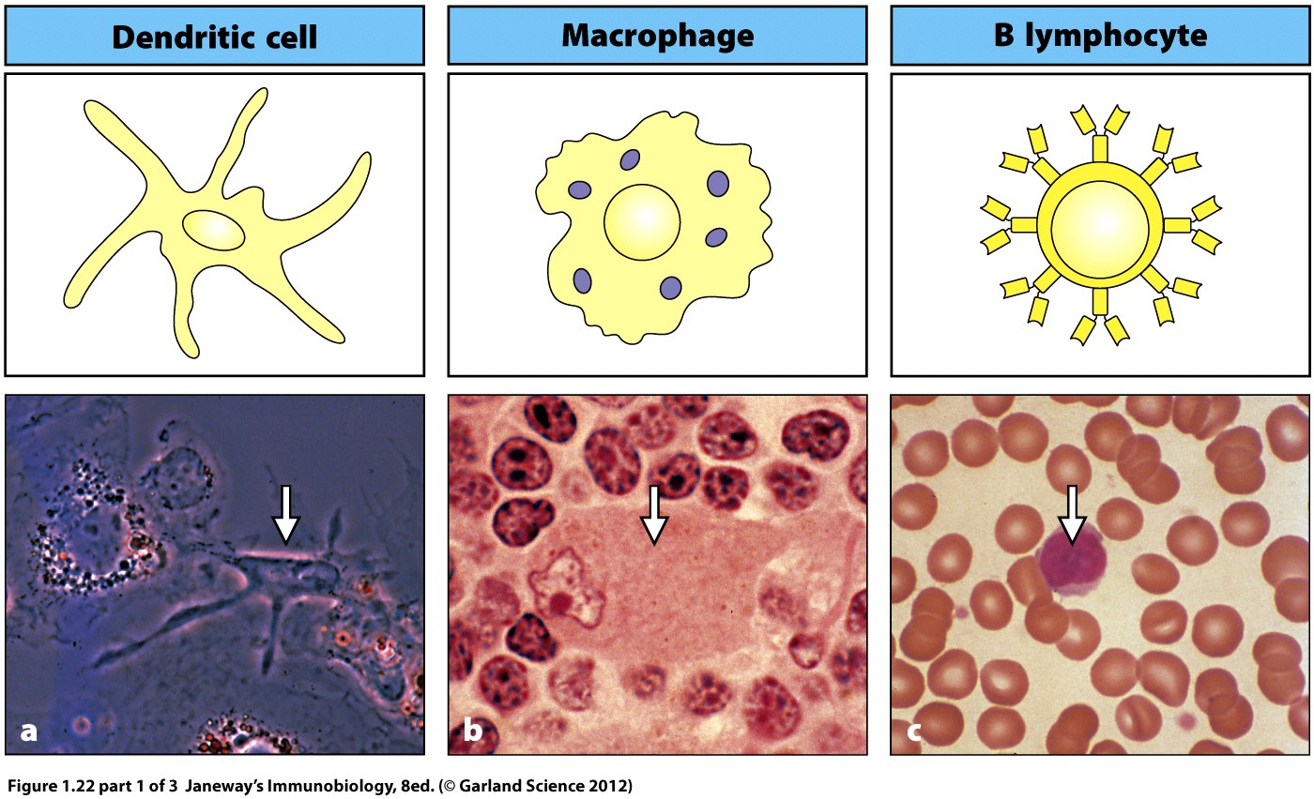
Antigen Presenting Cells
Department of Biochemistry and Biotechnology
Immunology

Slide 50
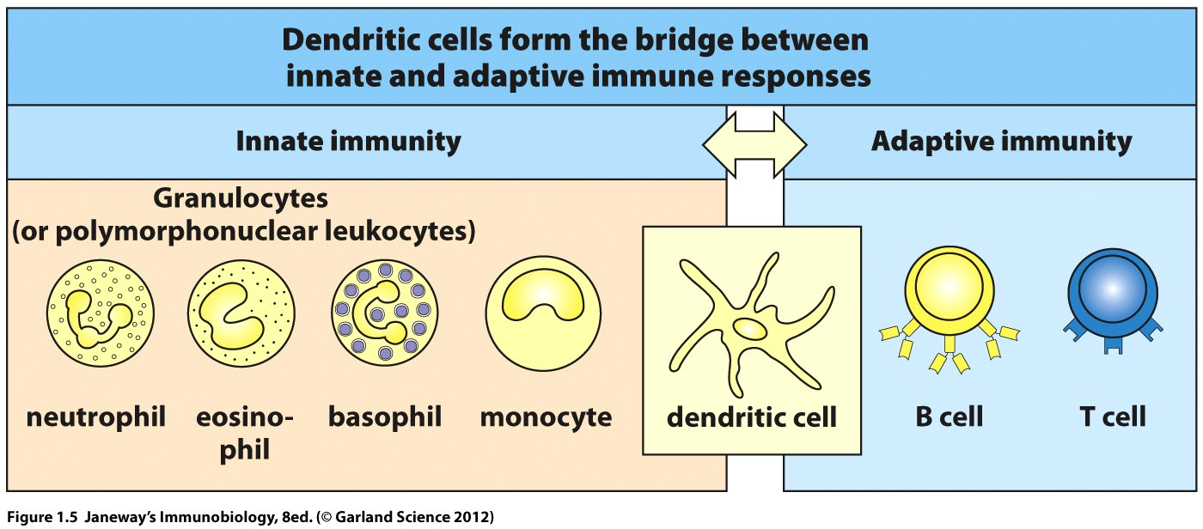
Dendritic cells link the Innate and the Adaptive immune system
Department of Biochemistry and Biotechnology
Immunology

Slide 51
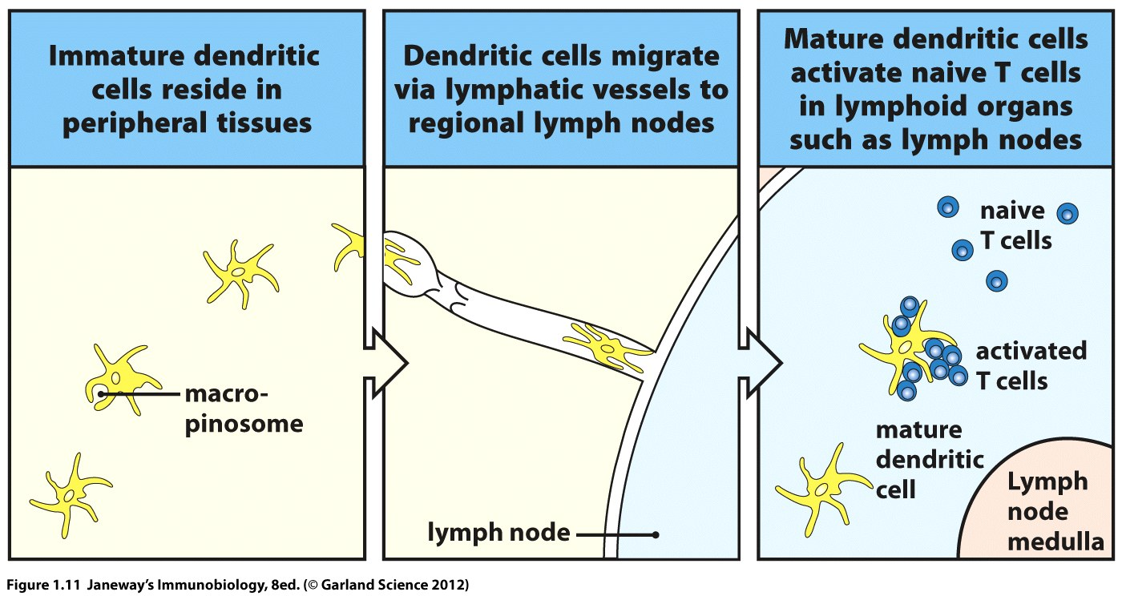
Dendritic cells form the bridge between innate and adaptive immune responses
Infection→ Activation
Sensing infections (innate function)
Antigen → specific T cell
Activation (adaptive function)
Department of Biochemistry and Biotechnology
Immunology

Slide 52
Features of Adaptive Response
Specificity
Division of Labor
Immunological Memory
Tolerance (central and peripheral)
Faster response
Department of Biochemistry and Biotechnology
Immunology

Slide 53
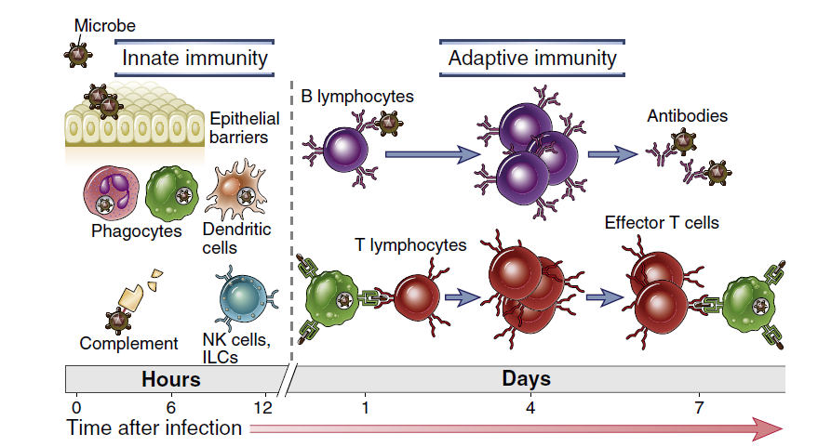
Innate and Adaptive Immunity
Department of Biochemistry and Biotechnology
Immunology

Slide 54
Phases of Immune Response
Department of Biochemistry and Biotechnology
Immunology

Slide 55
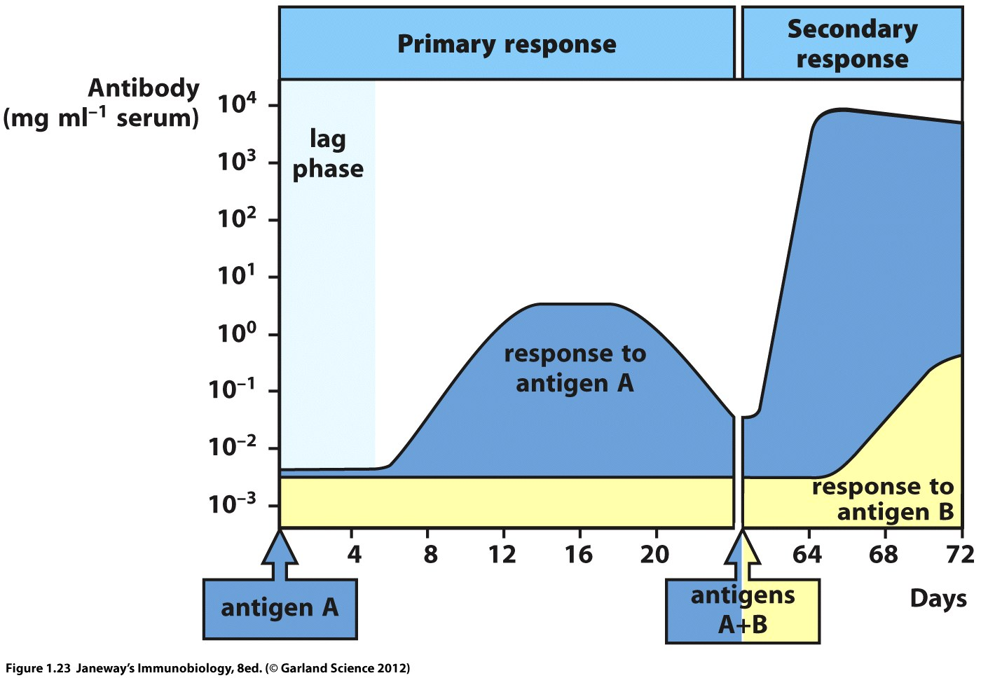
Features of Adaptive Response
The course of a typical antibody response
Department of Biochemistry and Biotechnology
Immunology

Slide 56
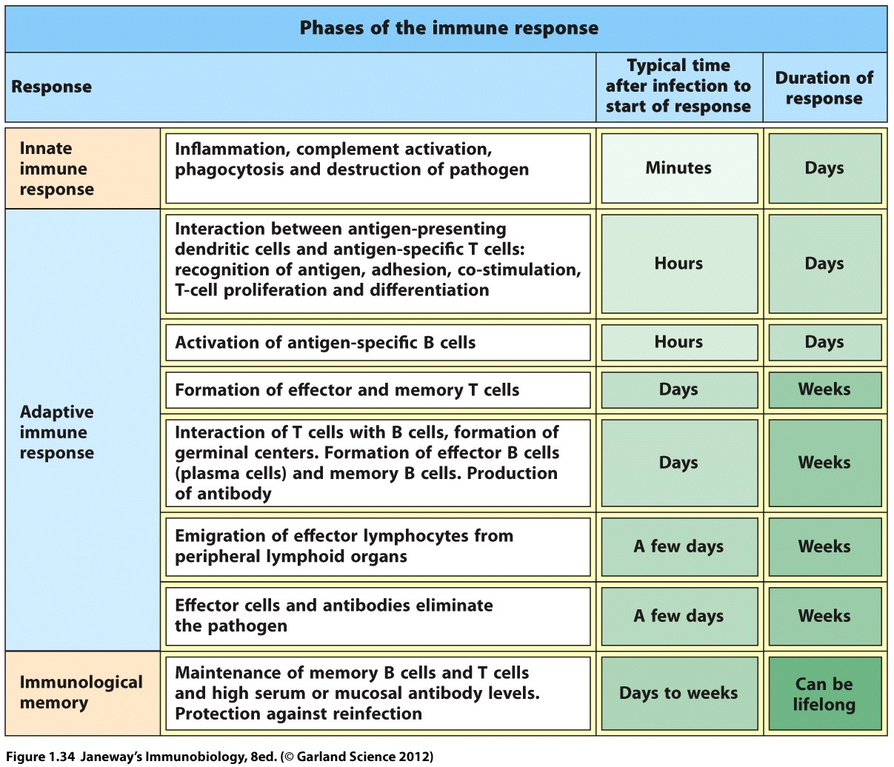
Department of Biochemistry and Biotechnology
Immunology

Slide 57
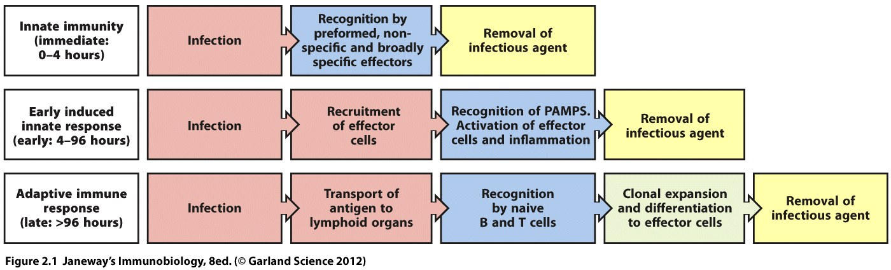
Summary
Department of Biochemistry and Biotechnology
Immunology

Slide 58
References
1. Paul, W.E. (ed): Fundamental Immunology, 6th ed. New York, Lippincott Williams & Wilkins, 2008
2. Kaufmann, S.E., Sher, A. and Ahmed, R. (Eds): Immunology of Infectious Diseases. Washington, DC: ASM Press, 2001.
3. Janeway Immunology (2012)
4. Nature Reviews Immunology (2016)
Department of Biochemistry and Biotechnology
Immunology

